Slide 1
SIT008 – Research Design in Practice
Week 4
Luke Sloan
Sampling & Selecting

Slide 2

Introduction
Populations vs Samples
Probability Sampling
Non-Probability Sampling
Sampling – Who to Ask
Sampling Problems
Non Response
The Million Dollar Question

Slide 3
Populations vs Samples I
A population is every possible person that could be included in your study
A population can still be (and normally is) a subset of the ‘world population’
For example, for a study into Cardiff University undergraduate students the population would be all Cardiff University students enrolled on an undergraduate course
A study that collects information about whole populations is technically called a ‘census’

Slide 4
Populations vs Samples II
A sample is a subset of the population
A sampling frame contains information about the whole population from which a sample is drawn
A study that collects information from a sample in an attempt to make inferences to a population is technically called a ‘survey’
Not all research designs want to infer characteristics from samples to populations and therefore do not need to have samples that are representative

Slide 5
Probability Sampling I
Probability sampling involves randomly selecting individuals from a population
A random sample should begin to represent the population as it increases in size
For example, how many people in this room have read the Harry Potter books…
The whole class is the ‘population’
What if I take a sample of 4 people and try to generalise?
What about 10 people?
20 people?
We can confirm how representative the sample is by conducting a census of this room, but normally the population is too large for this so we ‘infer’ characteristics from the sample to population
The larger the sample, the lower the chance of sampling error (although a certain level of error is normal) and the more certain we can be that our inference is correct – hence inferential statistics and the normal distribution

Slide 6
Probability Sampling II
Because the point of probability sampling is to infer from the sample to the population the sample is normally large
Therefore probability sampling is associated with, but not exclusive to, surveys which are easy to distribute in great numbers
If you only have a small sample then there’s also a chance that you could miss important groups (e.g. BME) hence the stratified random sample
Typically qualitative data analysis does not lend itself to small samples due to the richness of the data being collected so…

Slide 7
Non-Probability Sampling
For a non-probability sample individuals in the population do not have the same chance of being selected
Because of this we cannot make inferences from the sample to the population
In qualitative research generalisation of patterns is less important – all about context and critical of nomothetic explanations of the social world
Because of this non-probability sampling is associated with interviews, focus groups, observations etc…

Slide 8
Sampling – Who to Ask I
There are multiple approaches within the two families of sampling…
PROBABILITY SAMPLING
Every individual in the population has as equal a chance of being sampled as anyone else
Random Sample
Systematic Sample
Stratified Random Sample
NON-PROBABILITY SAMPLING
Some individuals in the population have a higher chance of being sampled than others
Convenience Sample
Snowball Sample
Quota Sample (e.g. by sex)
Truly ‘random’ is very hard to achieve
Typically clusters (spatial/ familial)

Slide 9
Sampling – Who to Ask II
An example in recruiting university students for a study…
Random Sample
Let a computer decide based on student ID
Systematic Sample
Take every 20th student in an unordered list
Stratified Random Sample
Identify groups, randomly select from each group, combine
Convenience Sample
Select the people you meet outside of the Union
Snowball Sample
Find one student you want to interview and ask them to find others
Quota Sample (e.g. by sex)
Select students outside Union but ensuring a 50/50 male-female split

Slide 10
Sampling Problems
There is no such thing as random
What if there is a systematic pattern? (e.g. dates?)
What groups do you use for stratification?
Is a convenience sample representative?
Do you want to be limited by social networks?
Quotas for sex, subject, hair colour…? How do you know?

Slide 11
Non Response
Not so much a sampling problem but is can still undermine the ability of probability samples to make inferences to the population
If responses are ‘missing at random’ (MAR) then you have little to worry about apart from a having a smaller sample
If responses are ‘not missing at random’ (NMAR) then we have a problem – you need to identify what characterises those who are not responding

Slide 12
Sample Weighting
Often some groups in a population tend to under-respond (typically BME) and because non response is a group characteristic it is considered to be ‘not missing at random’ (NMAR)
Ideally this would have been tackled by over-sampling groups with typically low response rates (a booster sample)
If this wasn’t done (or wasn’t successful) then at the data analysis stage cases from groups that are under represented can be ‘weighted up’
Alternatively cases from groups that are over represented can be ‘weighted down’
But you can only do this if you know the nature of the population (or else you don’t know what the weighting is!)

Slide 13
The Million Dollar Question I
How big should my (probability) sample be?
There is no answer to this question but you should consider the following:
Your resources are limited
Absolute size matters (not relative to population)
The bigger it is the lower the sample error
The law of diminishing returns (for 95% confidence level)...
Population size: | Req. Sample Size (5% margin of error) | Req. Sample Size (3% margin of error)
100 | 79 | 92
1,000 | 278 | 521
10,000 | 370 | 982
100,000 | 383 | 1077
1,000,000 | 384 | 1088

Slide 14
The Million Dollar Question II
How big should my (non-probability) sample be?
Again there is no answer to this, but there are many things to consider.
If you’re running case studies of unemployment in the Welsh Valleys, is one town enough?
Multiple case studies within the same town?
Multiple case studies of different towns?
Here’s an example of case study selection from my own work…

Slide 15
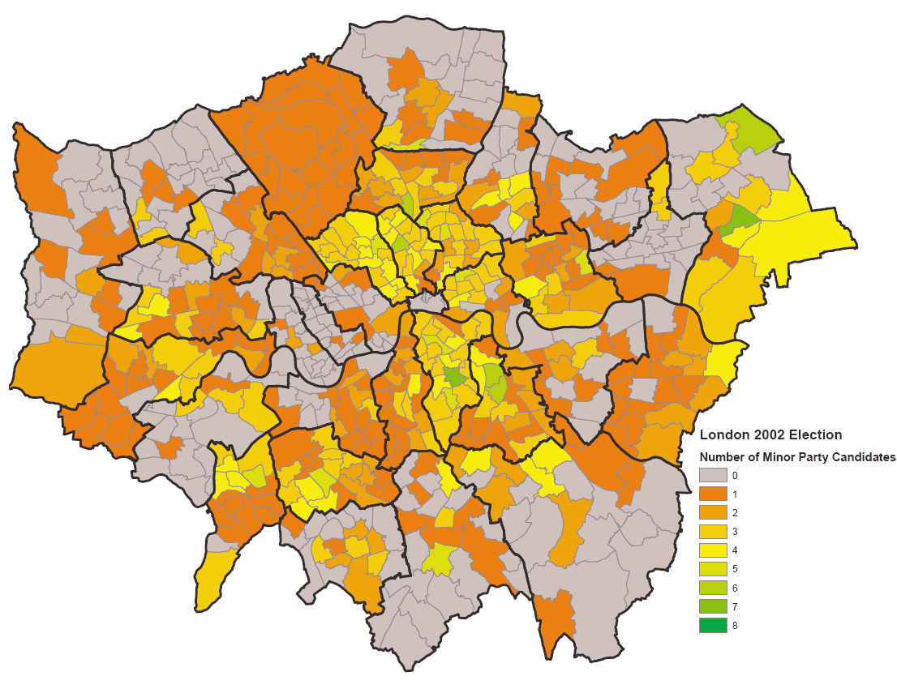
The Million Dollar Question III
Barnet
Southwark
Kensington & Chelsea

Slide 16
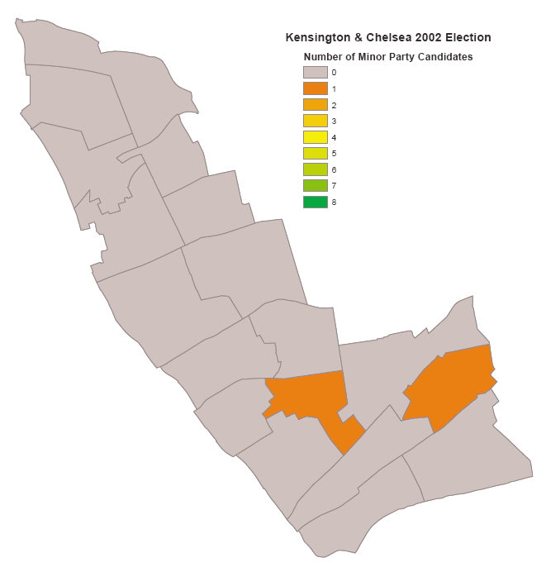
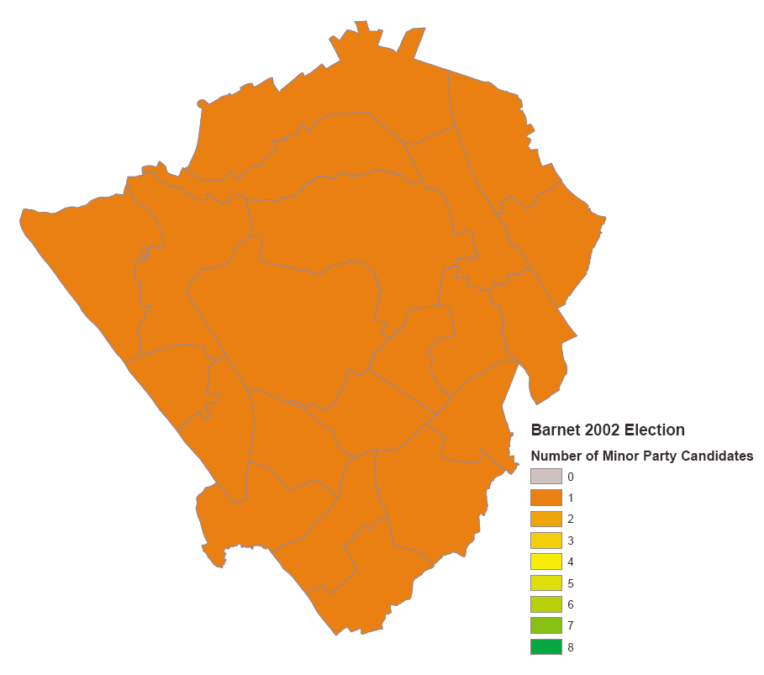
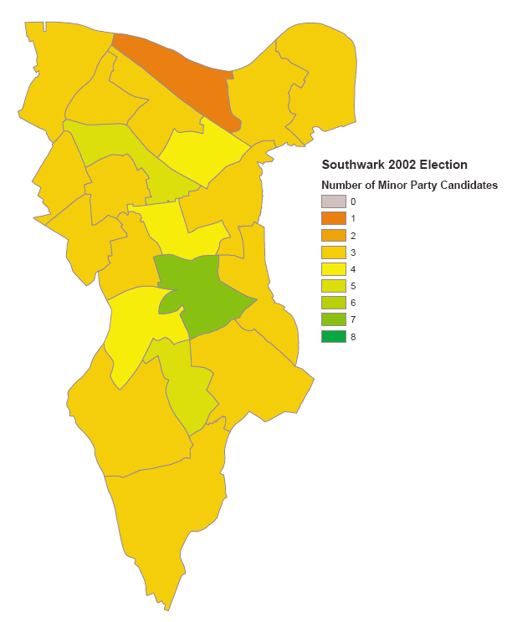
The Million Dollar Question III
Very little activity
Constant low activity
Highly variable activity
Note that the key to investigating each case study is comparison – why here and not there?

Slide 17
Group Activity
Scenario A:
I’m interested in understanding the shopping habits of people in Cardiff. I decide on the following sampling strategy:
I will collect data in person in the City Centre
I will administer a survey to passing shoppers
My sample will be split 50/50 male and female
I will also aim for 10% to be BME
Is this a suitable sampling strategy for such a project?
Can you think of any problems that might arise?
What other factors should we consider?

Slide 18
Group Activity
Scenario B:
I’m interested in understanding how Social Workers share and institutionalise good practice. I decide on the following sampling strategy:
I will collect data in person through interviews
I will carry out 6 interviews
I will conduct 2 interviews each in Swansea, Cardiff and Newport
I will interview experienced and newly qualified Social Workers
Is this a suitable sampling strategy for such a project?
Can you think of any problems that might arise?
What other factors should we consider?

